Slide 1
Forms with Bootstrap

Slide 2
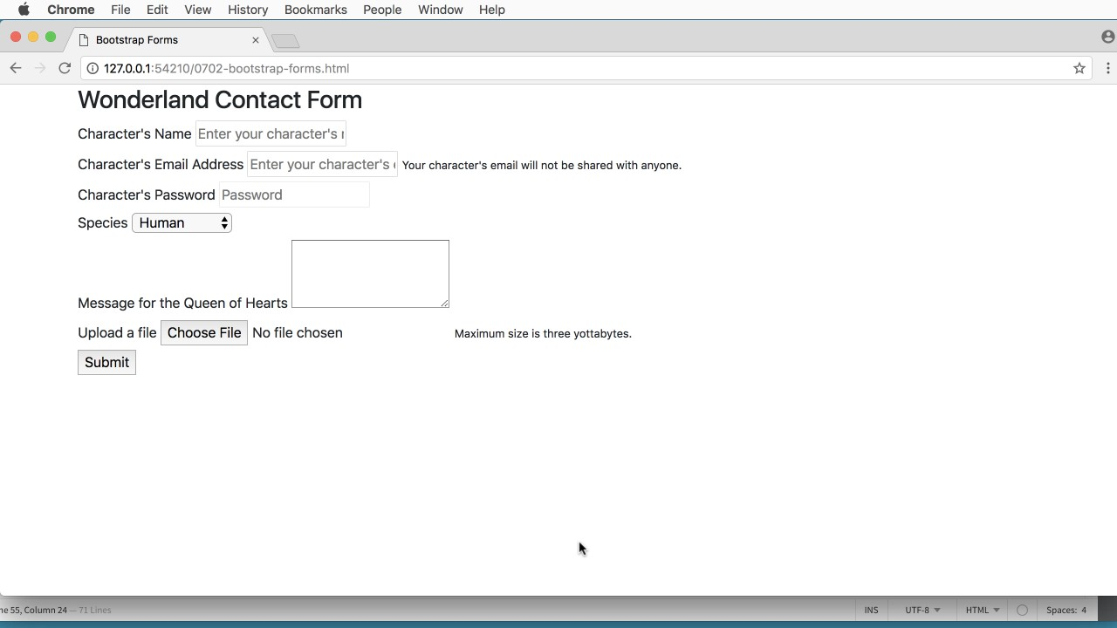

Slide 3
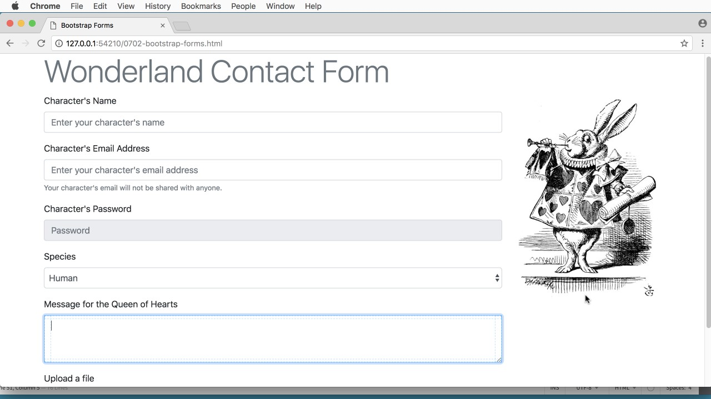

Slide 4
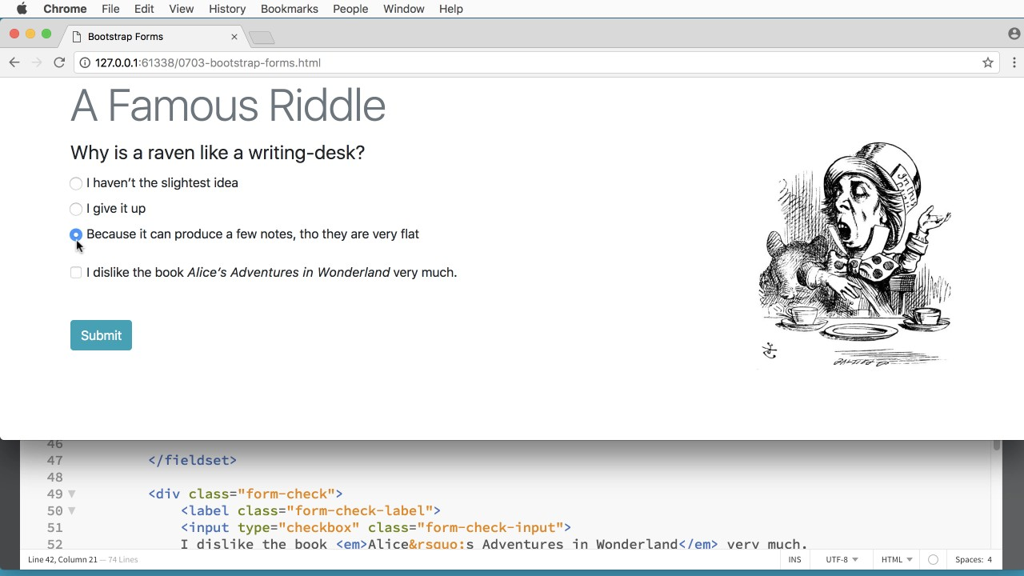

Slide 5
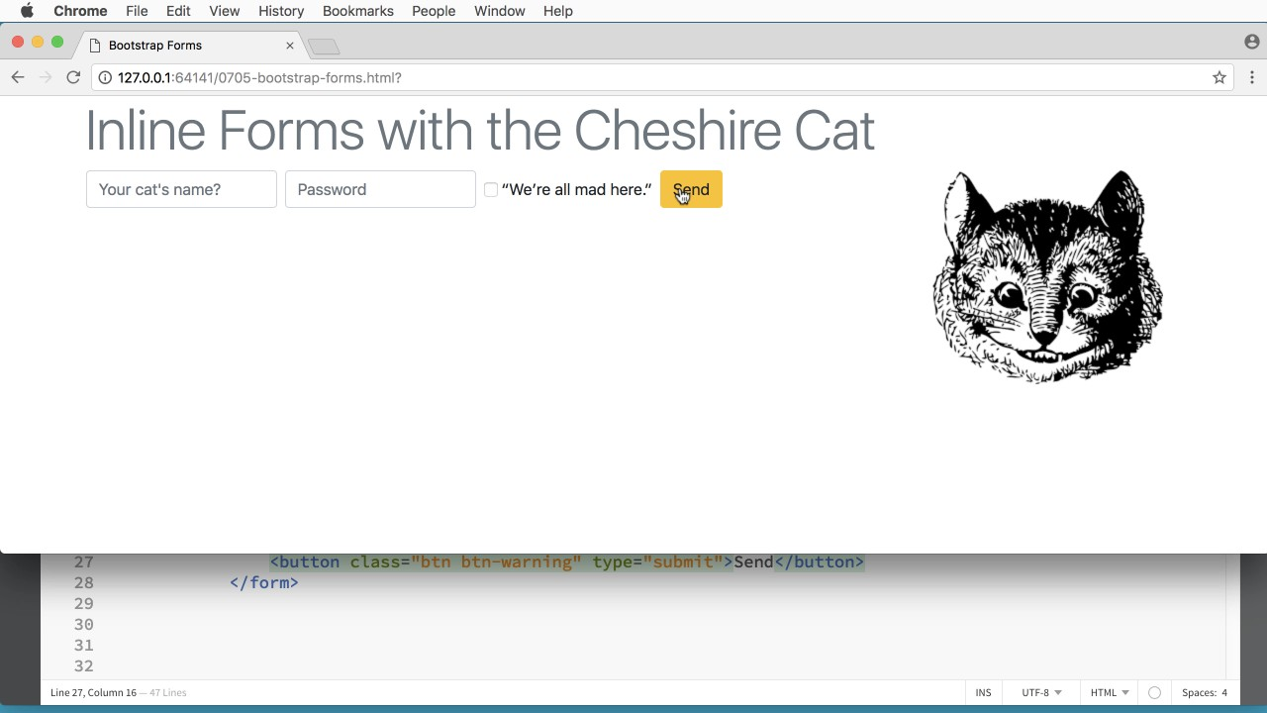

Slide 6
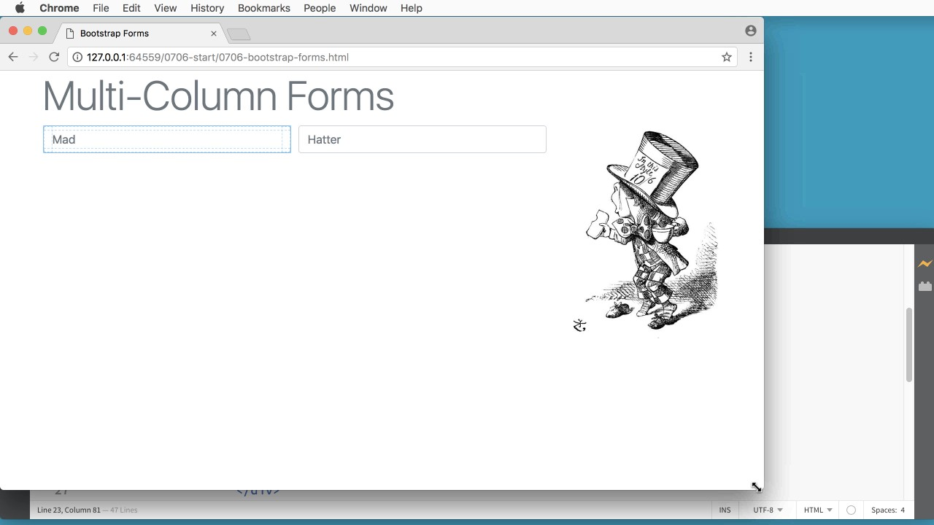

Slide 7
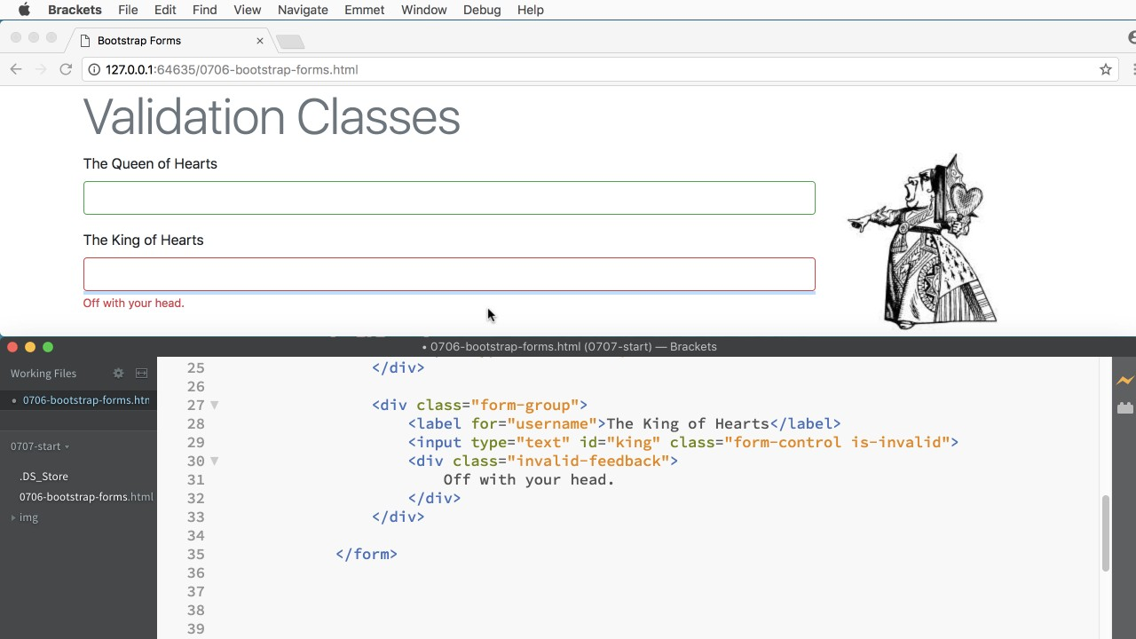

Slide 8
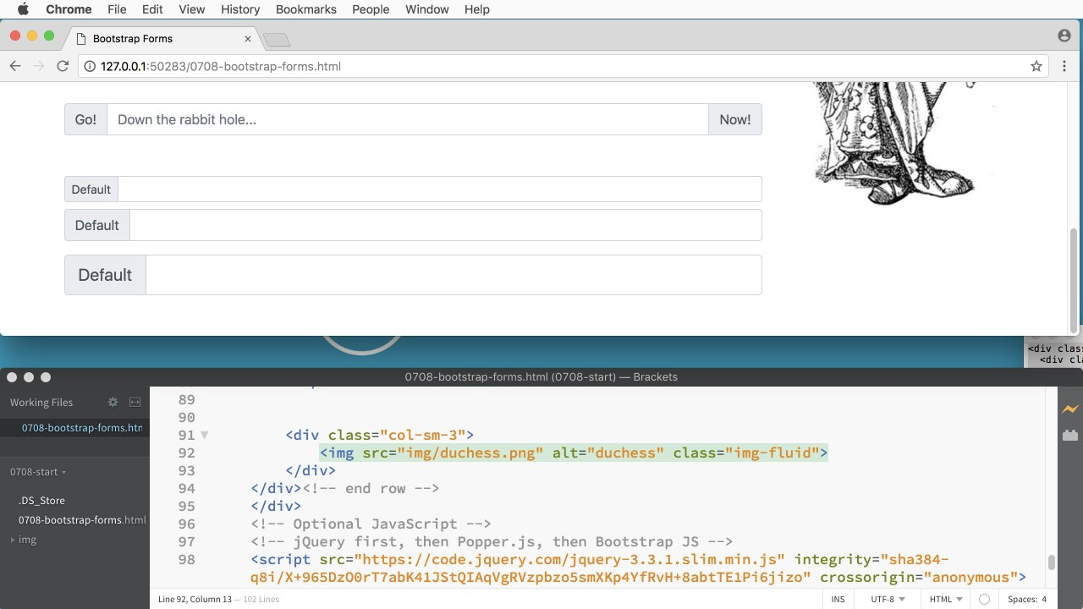

Slide 9
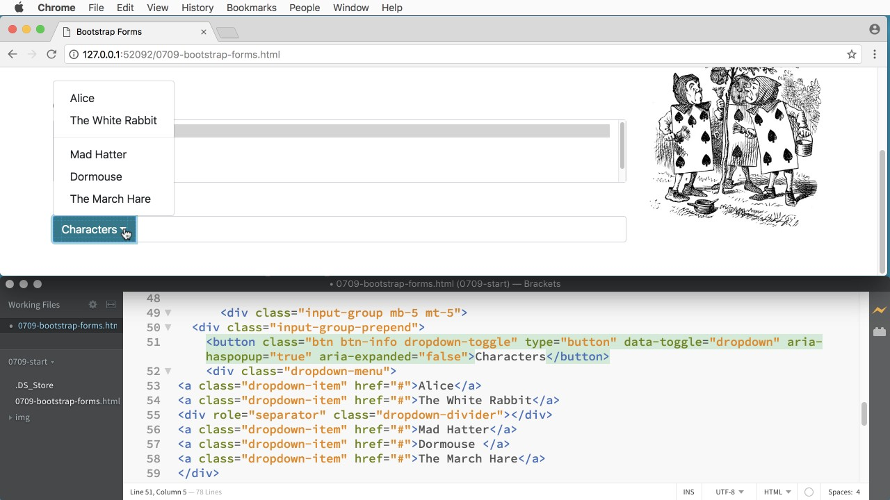

Slide 10
Let's get started.

Slide 11
Summary

Slide 12

Summary

Slide 13
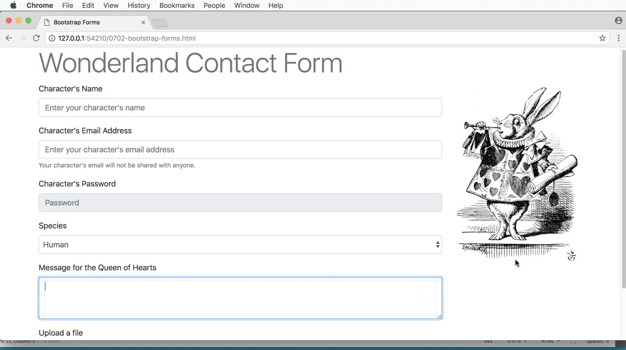
Summary

Slide 14

Summary

Slide 15

Summary

Slide 16

Summary

Slide 17

Summary

Slide 18

Summary

Slide 19

Summary

Slide 20


